Slide 1
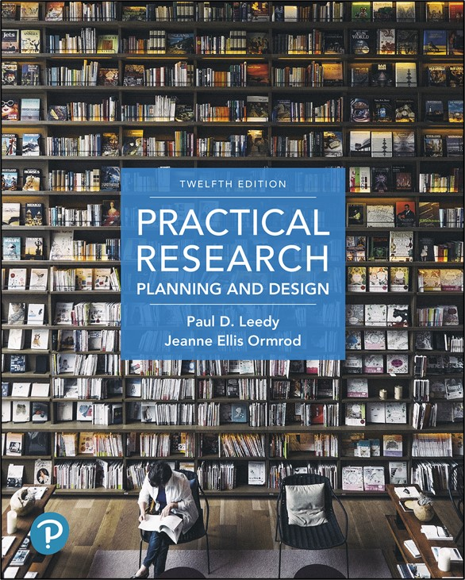
Practical Research: Planning and Design
Twelfth Edition
Chapter 2
The Problem: The Heart of the Research Process
Copyright © 2019, 2016, 2013 Pearson Education, Inc. All Rights Reserved
Notes:
If this PowerPoint presentation contains mathematical equations, you may need to check that your computer has the following installed:
1) Math Type Plugin
2) Math Player (free versions available)
3) NVDA Reader (free versions available)

Slide 2
Finding Research Projects
Research projects can be one of two types:
Basic research
Applied research

Slide 3
Basic Research
Enhances basic knowledge of
Physical world
Biological world
Psychological world
Social world
Sheds light on historical, cultural, or aesthetic phenomena

Slide 4
Applied Research
Addresses issues that have immediate relevance to current practices, procedures, and policies
Human decision making about practical problems
Questions in one’s immediate work environment (action research)

Slide 5
Identifying a Suitable Research Problem
Address an important question
The answer should make a difference
Advance the frontiers of knowledge by
leading to new ways of thinking
suggesting possible applications
paving the way for further research in the field

Slide 6
When Considering A Research Problem
Select a research problem
for more than self-enlightenment
to do more than compare two sets of data
to contribute something new
to identify and interpret a relationship
that has more than a yes/no answer

Slide 7
Finding a Legitimate Research Problem
Look around you
Read the literature
Seek the advice of experts
Attend professional conferences
Choose a topic that intrigues and motivates you
Choose a topic that others will find interesting and worthy of attention
Be realistic on what you can accomplish

Slide 8
Writing a Purpose Statement
Describe your problem or question clearly and completely
Think through the feasibility of the project that your purpose statement implies
Say precisely what you mean
Absolute honesty and integrity are the rule
Reflect an open mind about the solution
Edit your work

Slide 9
Dividing the Research Problem into Subproblems
Most problems are too big to tackle with just one question
Identify subproblems
A small number of completely researchable units
Subproblems usually consist of more specific questions that are easier to address and resolve

Slide 10
Subproblems V s. Pseudo-Subproblems
Some problems that arise are simply procedural in nature. Those problems are called pseudo-subproblems.
Pseudo-subproblems require decisions to be made before resolving the research problem and its subproblems.
With each pseudo-subproblem you must decide if it can be solved with common sense and creativity or if you need to acquire more knowledge to address the problem.

Slide 11
Characteristics of Subproblems
Should be a researchable issue in its own right
Must be clearly tied to the interpretation of data
Must add up to the totality of the problem
Should be small in number

Slide 12
Identifying Subproblems
Take a paper-and-pencil approach
Write down the problem
Critically examine for topics that require in-depth treatment. Draw a box around each topic
Make sure the text you’ve boxed has a need for data interpretation
Reorganize the ideas into a graphic that helps to identify the overall research design
Use brainstorming/mind-mapping software
Construct graphic networks of interrelated concepts, terms, and principles

Slide 13
Delineating the Problem
Every problem has a setting to establish
Identify a general theoretical or conceptual framework
State a priori hypotheses, if appropriate
Identify general concepts and specific variables
Define the terms
State the underlying assumptions
Identify delimitations and limitations, if applicable
These comprise the setting of the problem

Slide 14
Identifying a Relevant Theoretical or Conceptual Framework
Theoretical Framework: A preexisting or newly proposed set of concepts and principles that, in combination, might shed light on cause-and-effect and certain other relationships within the phenomenon under investigation
Conceptual Framework: Key concepts and inter-concept connections that, taken as a whole, provide a helpful “lens” through which the researcher looks at certain processes and can impose some sort of meaning

Slide 15
Stating Hypotheses
Hypotheses are intelligent, reasonable guesses about how a research problem or question might be resolved.
Hypotheses that a researcher poses in advance, usually in conjunction with the overall research problem or question and its subproblems, are known as a priori hypotheses.
Remember that researchers aren’t setting out to prove their hypotheses.
Ultimately, a priori hypotheses are nothing more than tentative propositions set forth to assist in guiding the investigation of a research problem or question.

Slide 16
Distinguishing between Research Hypotheses and Null Hypotheses in Quantitative Research
Research hypotheses are simply educated guesses that researchers hope their data might support.
Remember that researchers don’t set out to prove a hypothesis. Instead, they set out to cast doubt on- and therefore to reject- an opposite hypothesis.
This hypothesis is known as the null hypothesis.
The null hypothesis is not usually an a priori hypothesis, but it is used during statistical analyses.

Slide 17
Identifying the General Concepts and Possibly Also Specific Variables That are the Focus of the Investigation (1 of 7)
Explicit identification of variables at the beginning of a study is most common in quantitative research, especially in experimental studies
Identification of variables helps the researcher choose
an appropriate research design
an appropriate statistical analysis

Slide 18
Identifying the General Concepts and Possibly Also Specific Variables That are the Focus of the Investigation (2 of 7)
Variable: any quality or characteristic in a research investigation that has two or more possible values
Independent variable
researcher studies this variable as a possible cause of something else (may manipulate)
Dependent variable
potentially influenced by the independent variable, that is, may depend on the independent variable

Slide 19
Identifying the General Concepts and Possibly Also Specific Variables That are the Focus of the Investigation (3 of 7)
Example:
The consistency of ice cream (dependent variable – D V) depends on the temperature at which it’s stored (independent variable – I V)
High temperatures cause ice cream to melt, whereas low temperatures cause ice cream to be solid

Slide 20
Identifying the General Concepts and Possibly Also Specific Variables That are the Focus of the Investigation (4 of 7)
Mediating variables help explain why an independent variable has a particular effect on a dependent variable
Independent variable influences mediating variable, which in turn influences the dependent variable

Slide 21
Identifying the General Concepts and Possibly Also Specific Variables That are the Focus of the Investigation (5 of 7)
For example
confidence level
effort
performance
confidence level (I V) influences effort (mediator)
effort (mediator) influences performance quality (D V)
high confidence
more effort
great performance
low confidence
less effort
okay performance

Slide 22
Identifying the General Concepts and Possibly Also Specific Variables That are the Focus of the Investigation (6 of 7)
Moderating variables influence the nature & strength of relationship between I V and D V

Slide 23
Identifying the General Concepts and Possibly Also Specific Variables That are the Focus of the Investigation (7 of 7)
For example:
family income during childhood
problems later in life
low income
high maternal warmth
fewer
problems
low income
low maternal warmth
more
problems
high income
low maternal warmth
more
problems
income (I V) does NOT influence maternal warmth (moderator)

Slide 24
Defining Terms (1 of 2)
Each term should be defined as it will be used by the particular researcher
Operational definition: the definition of a characteristic or variable in terms of how it will be measured in the research study

Slide 25
Defining Terms (2 of 2)
Examples
self-confidence = score on a self-report questionnaire that has items such as “I can usually achieve what I set out to do” and “I think of myself as a smart person”
popularity = number of peers who specifically identify an individual as being a desirable social partner

Slide 26
Stating Assumptions
All assumptions that have a material bearing on the problem should be openly and unreservedly set forth
A statement of the assumptions is necessary for others to evaluate the conclusions of the study
A statement of the assumptions reveals what the researcher may be taking for granted with respect to the problem

Slide 27
Identifying Delimitations
Delimitations are statements about what the researcher is not going to do.
The researcher must distinguish between what is and what is not relevant to the problem.
For example, “I am interested in characteristics of X. I am not going to worry about influences on X.”

Slide 28
Identifying Limitations
The researcher must acknowledge weaknesses (limitations) that might cast doubt on results and conclusions
For example:
“My sample is small and possibly not representative”
“I have certain personal biases, such as X and Y, that may affect my observations and interpretation”

Slide 29
Writing the First Chapter or Section of a Research Proposal
In the first section of a proposal, you should outline:
The problem and its setting
Subproblems
Theoretical and/or conceptual framework
A priori hypotheses
Variables and key concepts
Assumptions, delimitations, and limitations
The importance of the study

Slide 30
Evaluating Your Proposed Research Project
In order to adequately evaluate your proposed research project, make sure you do the following:
Conduct a thorough literature review
Think concretely about how you will conduct the subsequent steps you must take in your project
Discuss your research problem or question with others
Remember that your project will take time- lots of time.
Remember that the first drafts of whatever you write will almost certainly NOT be your last ones

Slide 31

Copyright
This work is protected by United States copyright laws and is provided solely for the use of instructors in teaching their courses and assessing student learning. Dissemination or sale of any part of this work (including on the World Wide Web) will destroy the integrity of the work and is not permitted. The work and materials from it should never be made available to students except by instructors using the accompanying text in their classes. All recipients of this work are expected to abide by these restrictions and to honor the intended pedagogical purposes and the needs of other instructors who rely on these materials.

